Slide 1
Smart Calendar
Sanchana(C0765521)
Paras Dhand (C0758260)
Navneet Kaur (C0760074)
Tanya Puri (C0759737)

Slide 2
Introduction
Functionality
Personal Assistant [updating the calendar,setting up memo,weather,date,time etc.
Enquiry Centre [helpful in providing answers to our various questions using Alexa voice services.
Purpose
Multi-application screen serving as information & decoration.
Single glance at screen will be helpful in answering all the questions for day regarding weather,time, appointments etc

Slide 3
Block Diagram video and link
Microphone
Speaker
Raspberry pi
Alexa
QT
Cloud
Power Supply
Internet
LCD Screen

Slide 4
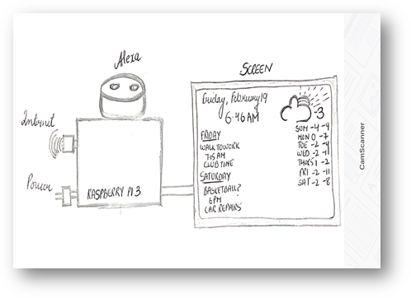
Concept
The concept behind the smart screen calendar is displaying useful information
To be productive and efficient, it becomes crucial to make most of the time available during the day.
The idea about the smart screen calendar is derived from the IOT concept.
Connecting Alexa using IOT enables the communication between user and a device.

Slide 5
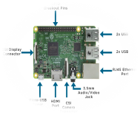


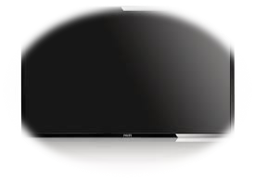
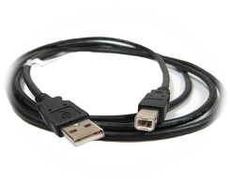
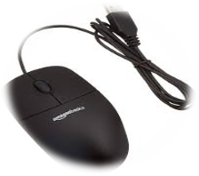
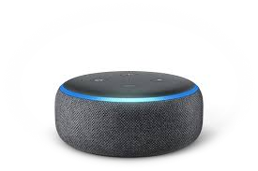
COMPONENTS
7 inch HDMI touch screen display for raspberry pi
Raspberry pi model 3B +
Speaker with audio jack 3.5mm
Microphone
HDMI cable
USB type C
SD Card
Keyboard
Mouse

Slide 6

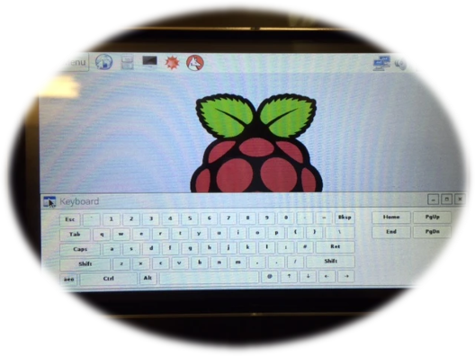
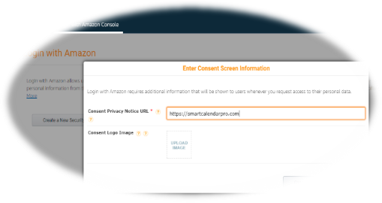
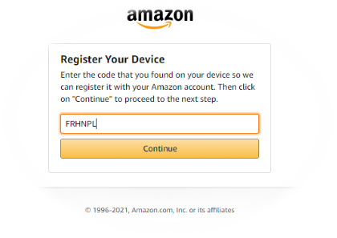
SOFTWARES
QT
Amazon developer account
Amazon Alexa account
Matchbox-keyboard

Slide 7

ABOUT QT
Used for developing GUIs,and multipurpose applications.
Also classified as widget toolkit.
Indicates the libraries(QT MODULES) used in the project .
C++ is the major language used to develop with QT.

Slide 8
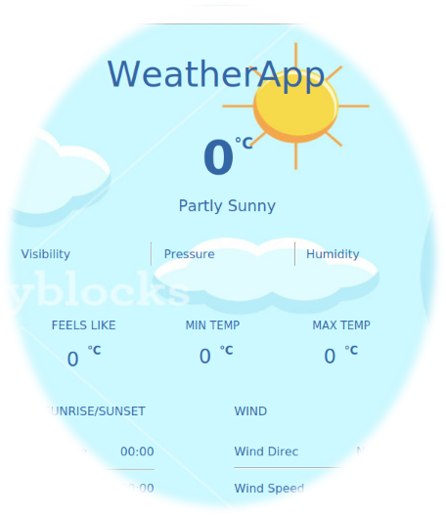
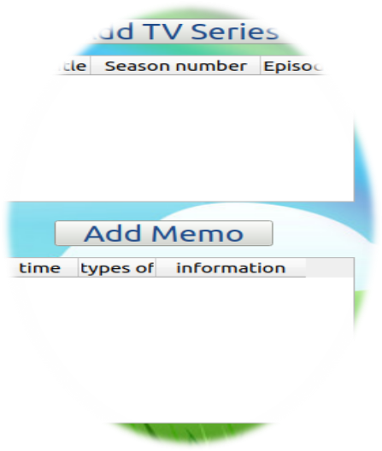
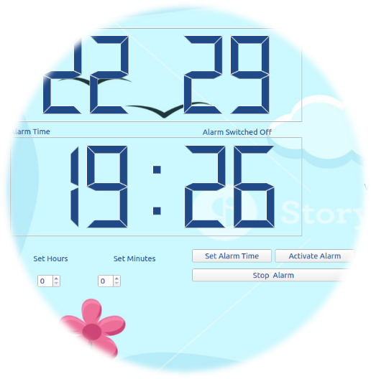
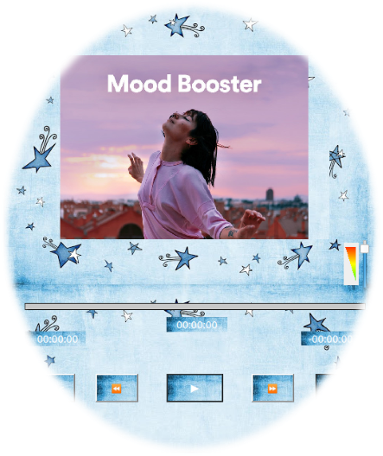
Functions using qt
Current Date and time
Weather Application
Memo
Adding TV Series
Diary
Alarm
Calendar
Music player

Slide 9
HEADER FILES
#include "mainwindow.h"
#include "ui_mainwindow.h"
#include <QApplication>
#include <QPushButton>
#include <string>
#include <QInputDialog>
#include <time.h>
#include <QFrame>
#include <QDebug>
#include <QDialog>
#include <QFile>
#include <string>
#include <QTextStream>
#include <QDir>
#include <QTableWidget>
#include <QTableView>
#include <QDir>
#include <QMessageBox>
#include <string>
#include <algorithm>
#include <QtMultimedia/QMediaPlayer>
#include <QUrl>
#include <QTime>
#include<QTimer>
#include<QDate>
#include "QtNetwork/QNetworkReply"
#include "QUrl"
#include "QUrlQuery"
#include "QtNetwork/QNetworkAccessManager"
#include "QtNetwork/QNetworkRequest"
#include "QJsonDocument"
#include "QJsonArray"
#include "QJsonObject"
#include <QPixmap>
All header files used in the qt programming.

Slide 10
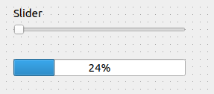
Signals & slot
Horizontal slider [throws the signal ]
Progress bar [receives the signal]
Changing the value of the slider brings the change in the value of the received signal.
Connect- Connecting objects signal and slot method.
connect(ui->horizontalSlider,SIGNAL(valueChanged(int)),
ui->progressBar,SLOT(setValue(int)));
connect (Object1,Signal1, Object2,Slot1)

Slide 11

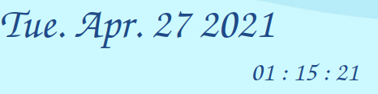
Date&time
https://github.com/parasdhand4/clock-time-qt

Slide 12
Header-files & code
#include <QTime>
#include<QDate>
QDate date=QDate::currentDate(); // show current date
QString datetext=date.toString();
ui->date->setText(datetext);
void MainWindow:: showTime()
{
QTime time=QTime::currentTime();
QString time_text=time.toString("hh : mm : ss"); // time
ui->Digital_clock->setText(time_text);
}
Include header files [QTime,QDate]
A QDate object contains a calendar date, i.e. year, month, and day numbers.
QString is passing the characters current date.
QDate is constructed with the static function currentDate()which creates a QDate object containing the system clock's date.

Slide 13
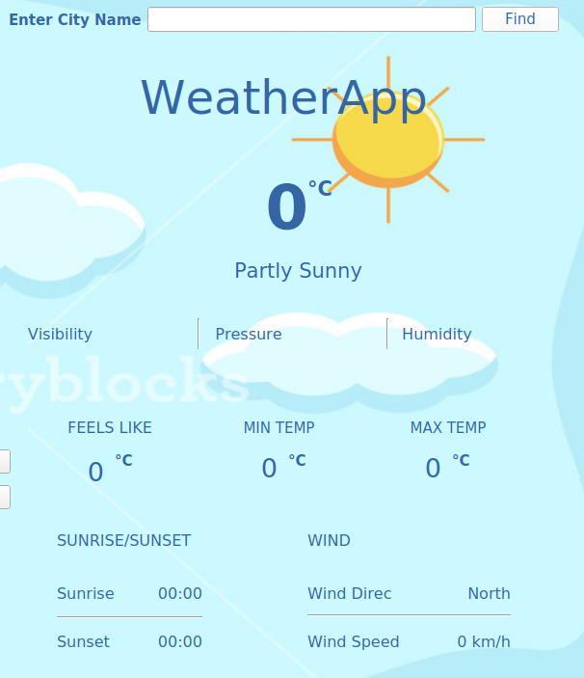
Weather
https://github.com/SmartCalendar-Project/Weather-app-qt

Slide 14
Weather code
void MainWindow::on_queryButton_2_clicked()
{
QString query = ui->query_2->text();
QUrl url("http://api.openweathermap.org/data/2.5/weather");
QUrlQuery attributes;
attributes.addQueryItem("q", query);
attributes.addQueryItem("appid", "3130fe9c95bcd429a94c61a79c4f7c32");
}
void MainWindow::displayWeatherData(QString jsonString){
QJsonDocument jsonResponse = QJsonDocument::fromJson(jsonString.toUtf8());
QJsonObject data = jsonResponse.object();
QJsonObject dataMain = data["main"].toObject();
QJsonObject dataWeather = data["weather"].toArray().at(0).toObject();
QJsonObject dataWind = data["wind"].toObject();
QJsonObject dataSys = data["sys"].toObject();
QString city = data["name"].toString();
QString countryCode = dataSys["country"].toString();
QString location = city.append(", ").append(countryCode);
QString weatherCondition = dataWeather["main"].toString();
int temp = dataMain["temp"].toDouble();
int feelsLike = dataMain["feels_like"].toDouble();
int tempMax = dataMain["temp_max"].toDouble();
int tempMin = dataMain["temp_min"].toDouble();
int pressure = dataMain["pressure"].toDouble();
int humidity = dataMain["humidity"].toDouble();
int visibility = data["visibility"].toDouble();
int windSpeed = dataWind["speed"].toDouble();
int windDirDegree = dataWind["deg"].toDouble();
int sunriseTimestamp = dataSys["sunrise"].toInt();
int sunsetTimestamp = dataSys["sunset"].toInt();
The weather-app uses the data provided by openweathermap api.
Query strings are used to transmit options in the URL decoded into multiple key-value pairs.
The most common way of parsing a query string is to initialize it in constructor by passing it the query string.
Json are the unique strings which returns the different information from the url.

Slide 15
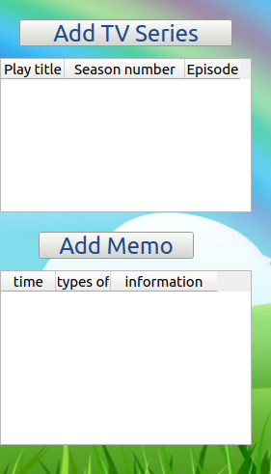
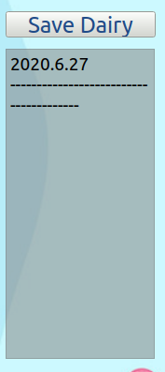
Memo,tv ,diary
://github.com/SmartCalendar-Project/Calendar-Display

Slide 16
Memo code
void MainWindow::memo_show()
{
QDir temp;
if(!temp.exists(location+"/memo") || !temp.exists(location+"/memo_content")){
QMessageBox::about(this,"warning","Can't find the destination folder");
return;
}
if(day<0){
return;
}
date_gonna_print=day;
QString filename = s2q(std::to_string(year)+"."+std::to_string(month)+"."
+std::to_string(date_gonna_print)+".memo");
QString memoname = filename + ".txt";
QFile file(location+"/memo"+"/"+memoname);
int count=0;
if(file.open(QIODevice::ReadOnly|QIODevice::Text)){
for(int i=0;!file.atEnd();i++){
QString str=file.readLine();
count++;
}
}
A QDir is used to manipulate path names, access information regarding paths and files and If the location of memo is not found it will return the warning message.
Else it will give access to set reminder and message with selected year,month and date.

Slide 17
Diary code
void MainWindow::textedit_show() //function called
{
QDir temp;lder");
return;
}
date_gonna_print=day;
if(!temp.exists(location+"/dialy"))
{
QMessageBox::about(this,"warning","Can't find the destination fo
QString filename = s2q(std::to_string(year)+"."+std::to_string(month)+"."
+std::to_string(date_gonna_print));
dialyname=filename+".txt";
QString start_print=s2q(std::to_string(year)+"."+std::to_string(month)+"."
+std::to_string(date_gonna_print))+"\n"+"---------------------------------------\n";
QFile file(location+"/dialy"+"/"+dialyname);
QString text="";
if(file.open(QIODevice::ReadOnly|QIODevice::Text)){
QTextStream text_TS(&file);
text = text_TS.readAll();
}
else text = "";
file.close();
QString today_print = start_print + text;
ui->textEdit->setText(today_print);
}
textedit_show() is a function recalled for diary.
QMessageBox::about(this,"warning","Can't find the destination folder"); return- returns the message if destination is not found.
Qstring file name displays the year,month and date respectively when we run the program.
Every note made in diary as a different date, time and month which is saved in allocated diary folder.

Slide 18
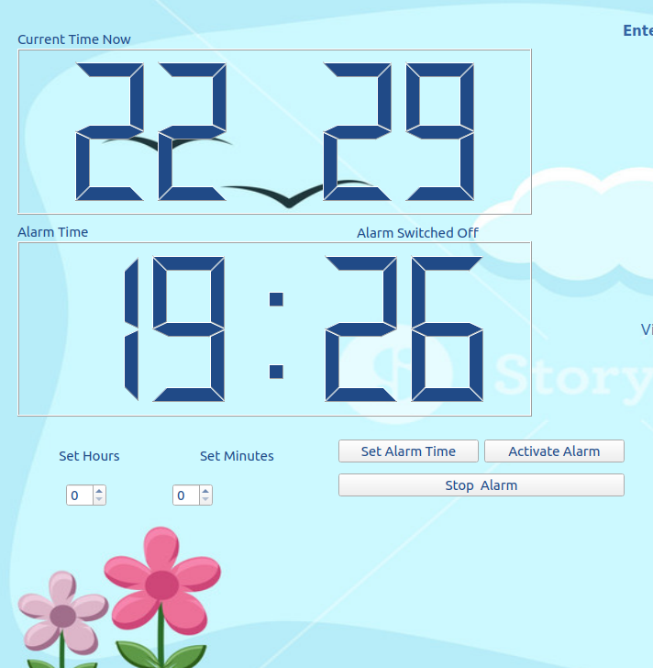
Alarm code
https://github.com/parasdhand4/Alarm-Weather-Qt

Slide 19
Alarm code
void MainWindow::setalarmtime()
{
// get the int value from the spingbox
int ihours = ui->spinBoxHrs->value() ;
int iminutes =ui->spinBoxMinutes->value() ;
void MainWindow::on_btnStopAlarm_clicked()
{
alarm_time ="00:00" ;
ui->lblalarmstatus->setText("Alarm Switched Off");
QPalette *p = new QPalette; // change lcd color
p->setColor(QPalette::WindowText, QColor(0, 0, 255));
ui->lblalarmstatus->setPalette(*p);
ui->alarmLCD->display(alarm_time);
flag =false ;
isSetFlag =false ;
m_thread->stop= true ;
f_fired= false ;
void mthread::run()
{
QMutex mutex ;
for(int i =0 ;i < 100 ;i++){
mutex.lock() ;
if (this->stop)
break ;
mutex.unlock();
emit this->AlarmFired()
}
SpinBoxHrs and SpinBoxMinutes widget are used to set value in alarm.
The purpose of a QMutex is to protect an object,so that only one thread can access it at a time.
It means at One time only single alarm can be set.
When you call lock() in a thread, other threads that try to call lock() in the same place will block until the thread that got the lock calls unlock().

Slide 20
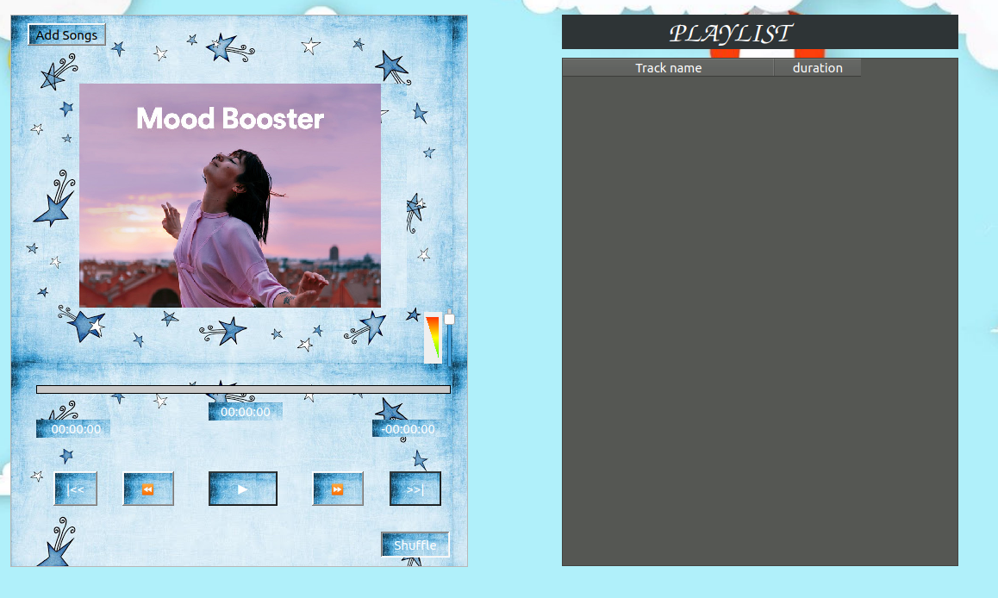
Music player
https://github.com/parasdhand4/qt_music

Slide 21
Music player code
void MainWindow::on_play_clicked(bool checked)
{
}
void MainWindow::onChange(QMediaPlayer::State state){
switch(state){
case QMediaPlayer::StoppedState:
{
ui->play->setText(QString("▶"));
}
break;
}
}
void MainWindow::on_play_clicked()
{
if(!playlist->mediaCount())
return ;
if(player->state() == QMediaPlayer::PlayingState){
player->pause();
ui->play->setText(QString("▶"));
}
else{
player->play();
ui->play->setText(QString("⏸"));
}
}
void MainWindow::on_next_clicked()
{
playlist->next();
}
void MainWindow::on_previous_clicked()
{
playlist->previous();
}
QPixmap pix("/home/navneet/qt_final/image/ab67706f00000003aa93fe4e8c2d24fc62556cba.jpeg");
ui->label_pic->setPixmap(pix.scaled(400,350,Qt::KeepAspectRatio));
ini.loadData();
The QMediaPlayer class is a media playback class. It can be used to playback content such as movies and song.
QString holds the role of the audio stream played by the media player.
A QPixmap can easily be displayed on the screen using QLabel.It designed and optimized for showing images on screen.

Slide 22
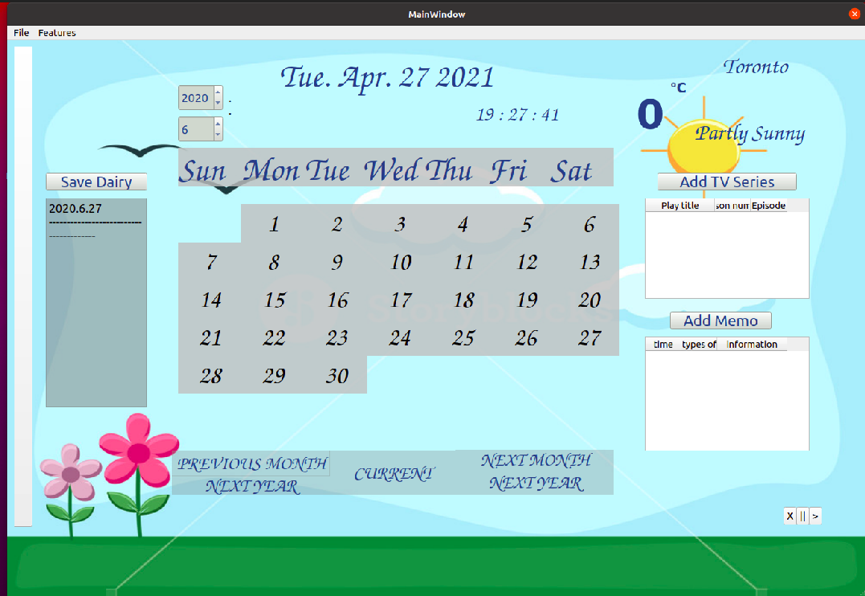
Calendar view
https://github.com/SmartCalendar-Project/qt_final/blob/main/mainwindow.cpp

Slide 23
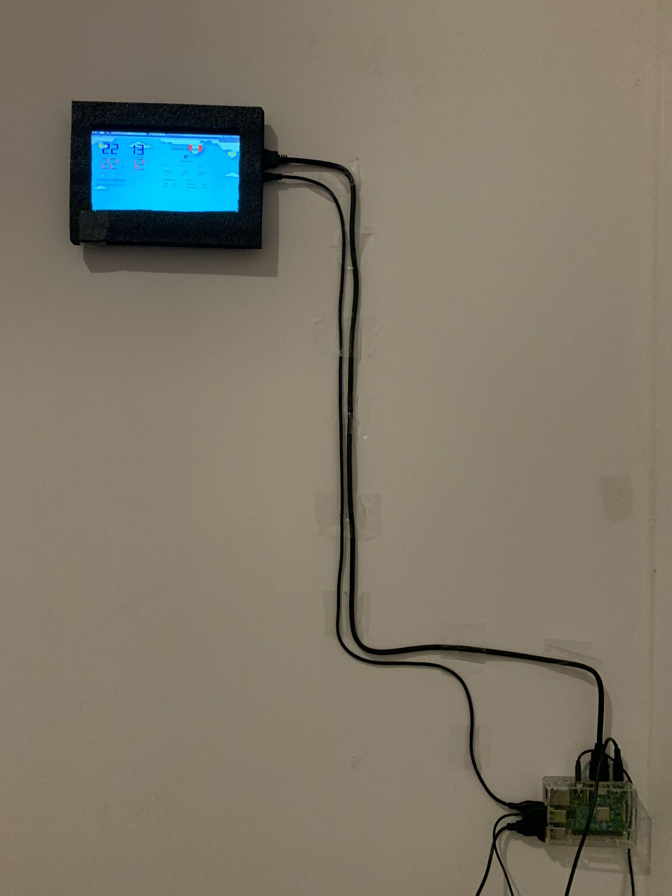
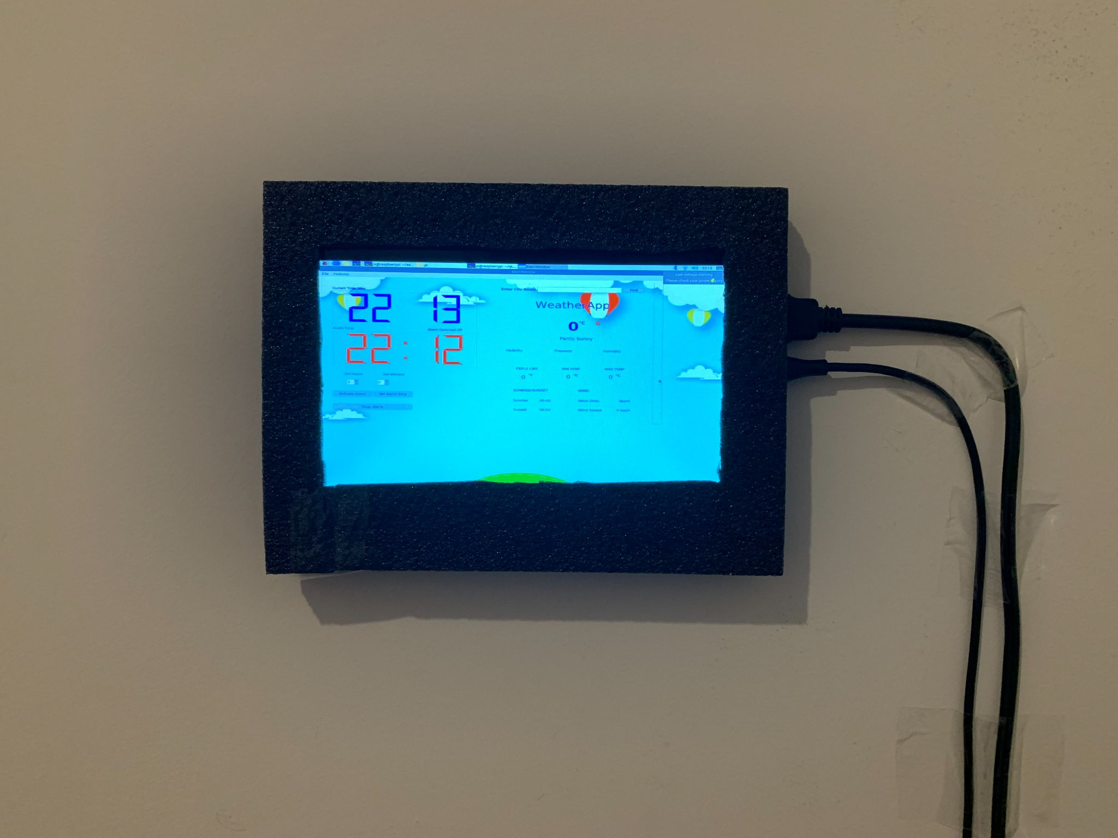
Calendar screen on a wall

Slide 24
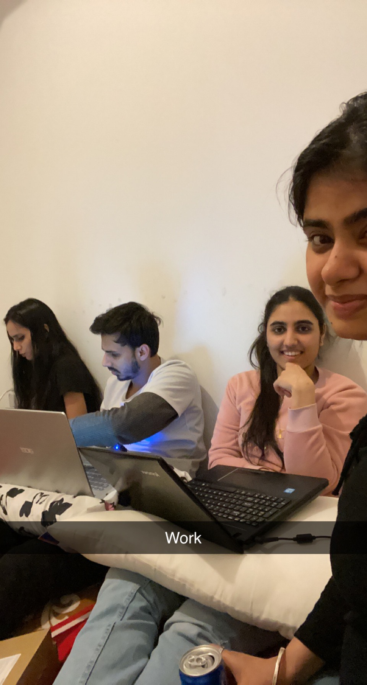
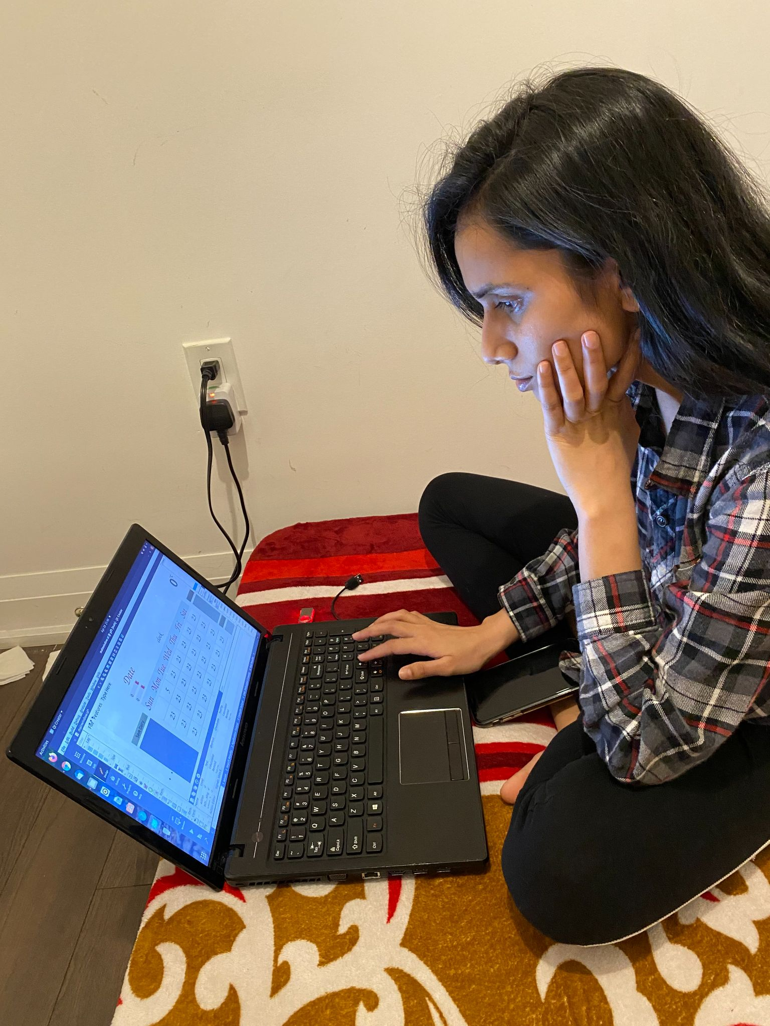
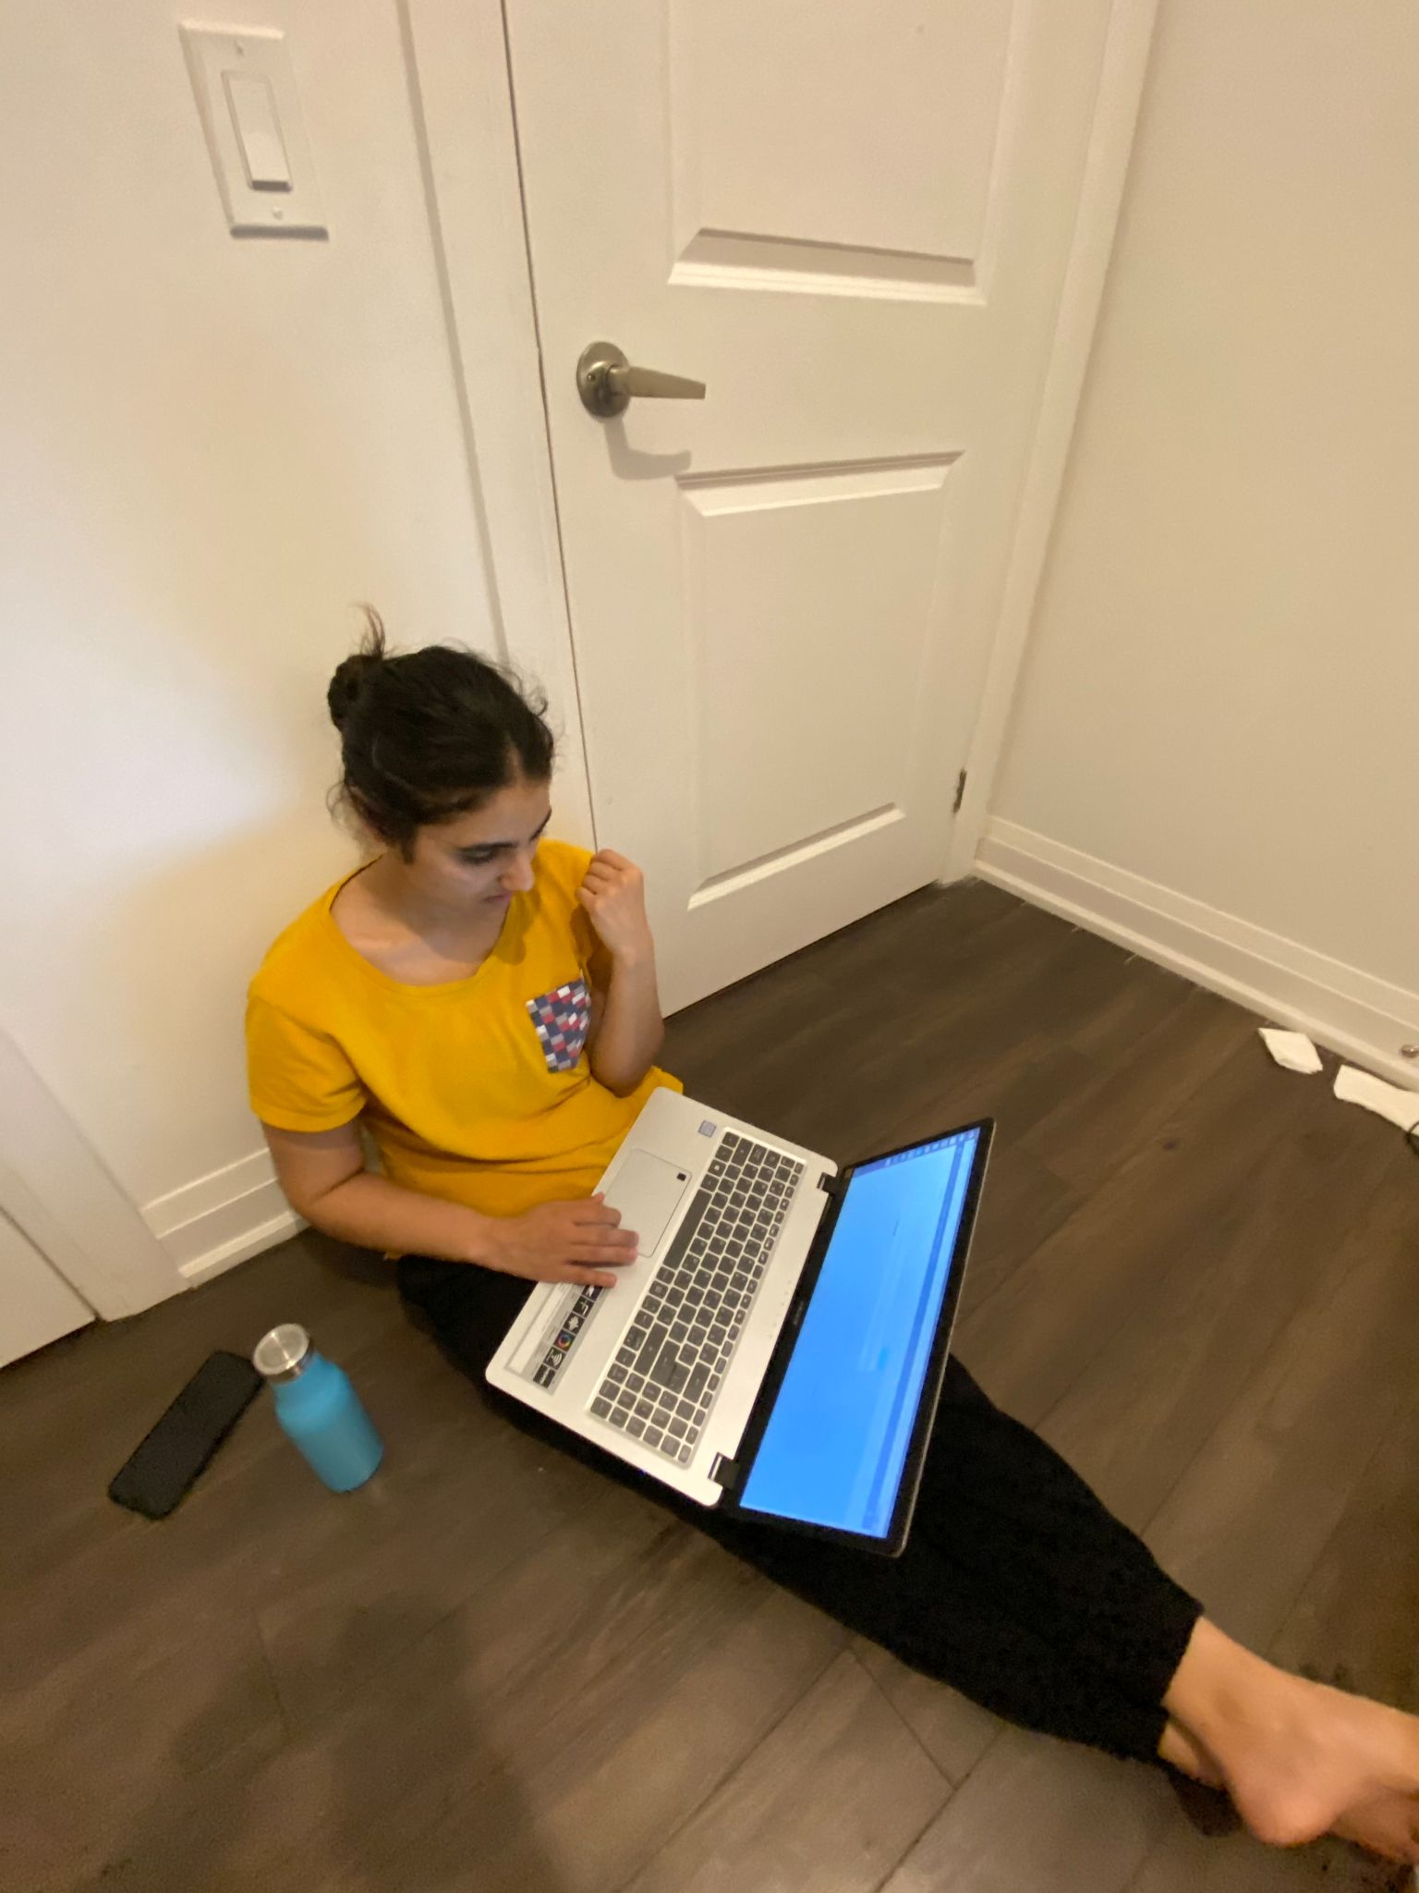
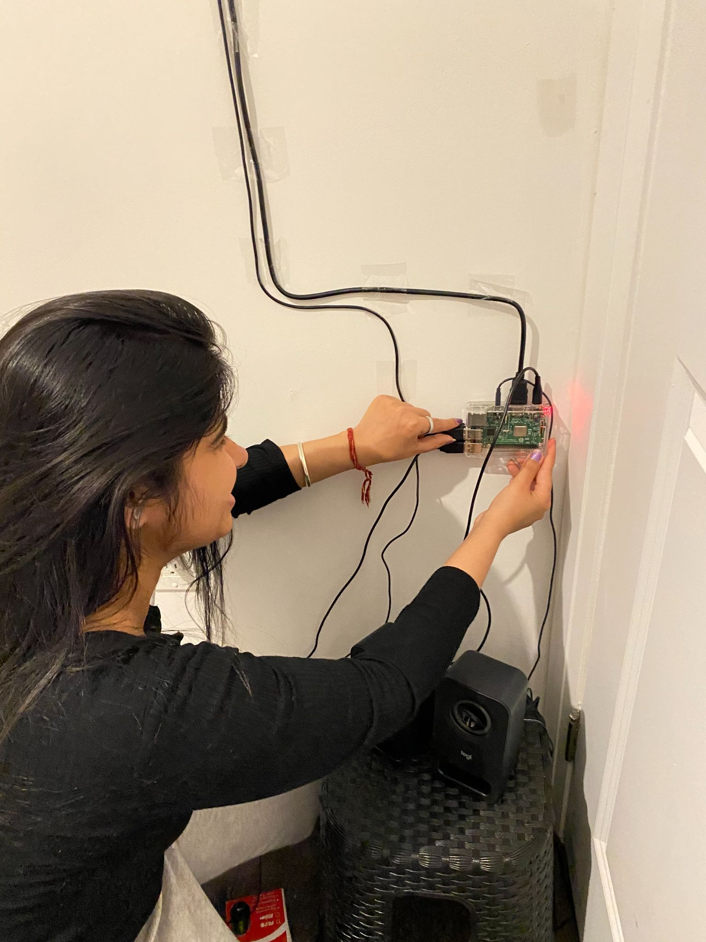
Work in progress images

Slide 25
Calendar view
JulDate::JulDate(int a,int b,int c,int d,int e,int f):year(a),month(b),date(c),hour(d),minute(e),second(f){}
int JulDate::getweek(){
JulDate base(1900,1,1,0,0,0);
int days=JulDate::minus(*this,base);
int week = days%7;
int JulDate::dayofmonth(int year,int month){
if (month==2 && JulDate::test_year(year))
return 29;
else if(month==2)
return 28;
else if(month==1||month==3||month==5||month==7||month==8||month==10||month==12)
return 31;
else if (month==4||month==6||month==9||month==11)
return 30;
}
void MainWindow::set_wallpaper()
{
if(month==12 && day==28){
this->setStyleSheet("#MainWindow { border-image: url(:/image/image/77.jpg);}#MainWindow * { border-image:url(); };");
}
The JUL() function returns the Julian day number for a given date.The Julian day is the continuous count of days .
Dates are stored internally as a Julian Day number, an integer count of every day in a
continuous range.
For any field that is not represented in the format the following defaults are used (1900,1,1) .
2nd Month will have 29 or 28 days.
1,3,5,7,8,10,12th month of the year will return 31 days.
4,6,9,11th month of the year will return 30 days
Default wallpaper changes with the of change of each day & month.

Slide 26
Shift in month & year
ui->spinBox_year->setRange(1900,2999);
ui->spinBox_month->setRange(1,12);
ui->spinBox_year->setValue(year);
ui->spinBox_month->setValue(month);
void MainWindow::on_next_month_clicked()
{
if(year==2999 && month==12){
month=12;
}
else month++;
if(month>12){
year++;
month=1;
}
void MainWindow::on_last_month_clicked()
{
if(year==1900 && month==1){
month=1;
}
else month--;
if(month==0){
year--;
month=12;
}
QSpinBox is designed to handle integers and discrete sets of values (e.g., month,years ).
ui->spinBox_year->setRange(1900,2999)- setting the range of year from 1900 to 2999.
ui->spinBox_month->setRange(1,12);-setting the range of month upto 12.
ui->spinBox_year->setValue(year);- assigning the value of year in spinbox.
ui->spinBox_month->setValue(month);assigning the value of month in spinbox.
on_last_month_clicked() will decrement 1 month from the current showing month.
on_next_month_clicked() will increment 1 month from the current showing month.

Slide 27
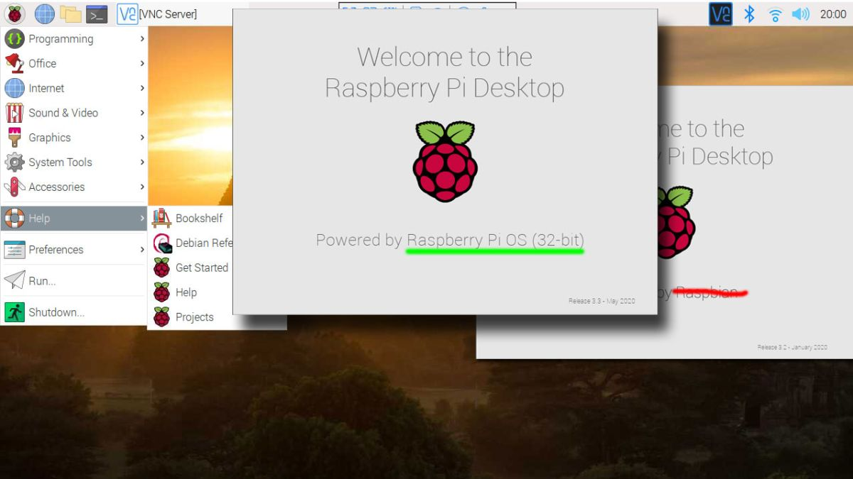
Getting Raspbian !!!
There are following steps to install Raspbian on Raspberry Pi
Download Raspbian from official website of raspberry pi (www.rasperrypi.org )
After downloading the Zip file , extract files on desired folder .
Copy all Files and paste in SD card
Sudo apt-get update and upgrade in terminal.
Adding SD card in Raspberry pi to boot up
Raspbian is installed

Slide 28
VOICE ASSISTANT: ALEXA
Alexa can be used as a voice assistant in smart calendar to take notes, remembering birthdays, setting alarms,to check temperature and many more things.
Any device with speaker and microphone can be turned into an Alexa.Alexa could be made using raspberry pi 3 Model B+, Speaker, Microphone, raspbian flashed SD card,a display and Alexa skill kit.A little knowledge of python or json language is also required.

Slide 29
Step 1:Registering new product with alexa voice service
Create an amazon developer account using amazon id
Select Alexa voice services -> Manage Product -> Add New product
Register Product with Avs ( Entering product name , ID etc.)
Setting Avs Security Profile -> security profile ID is generated -> click download config.json file -> save file .
https://github.com/SmartCalendar-Project/AVS-Device-SDK-on-ubuntu
config.json file can be found at https://github.com/SmartCalendar-Project/congf

Slide 30
Step 2: Setting environment of raspberry pi
Create necessary folders
Update raspberry pi using sudo apt-get update
Install dependencies using
$ sudo apt-get -y install \
$ git gcc cmake build-essential libsqlite3-dev libcurl4-openssl-dev libfaad-dev \
libssl-dev libsoup2.4-dev libgcrypt20-dev libgstreamer-plugins-bad1.0-dev \
gstreamer1.0-plugins-good libasound2-dev doxygen
Install port audio and run make

Slide 31
Step 3: Download avs device sdk
After setting environment clone SDK from github repositories using
cd /home/pi/sdk-folder/sdk-source
git clone --single-branch git://github.com/alexa/avs-device-sdk.git
Clone sensory wake engine
cd /home/pi/sdk-folder/third-party
git clone git://github.com/Sensory/alexa-rpi.git
And then finally run license script
cd /home/pi/sdk-folder/third-party/alexa-rpi/bin/
./license.sh

Slide 32
Step 4:Building the SDK
Next step is to build the SDK dependencies and Sample App
cd /home/pi/sdk-folder/sdk-build
cmake /home/pi/sdk-folder/sdk-source/avs-device-sdk \
-DSENSORY_KEY_WORD_DETECTOR=ON \
-DSENSORY_KEY_WORD_DETECTOR_LIB_PATH=/home/pi/sdk-folder/third-party/alexa-rpi/lib/libsnsr.a \
-DSENSORY_KEY_WORD_DETECTOR_INCLUDE_DIR=/home/pi/sdk-folder/third-party/alexa-rpi/include \
-DGSTREAMER_MEDIA_PLAYER=ON \
-DPORTAUDIO=ON \
-DPORTAUDIO_LIB_PATH=/home/pi/sdk-folder/third-party/portaudio/lib/.libs/libportaudio.a \
-DPORTAUDIO_INCLUDE_DIR=/home/pi/sdk-folder/third-party/portaudio/include
make SampleApp

Slide 33
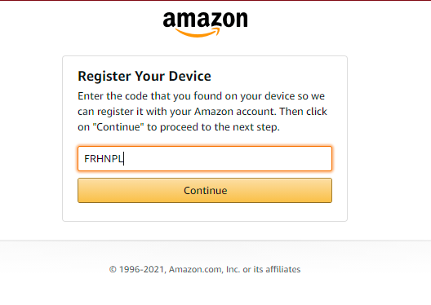
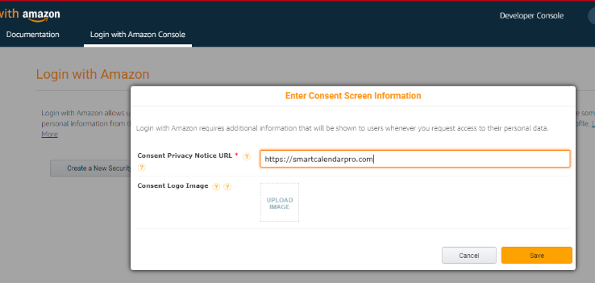
Step 5: Authorizing the device
Authorization is done when we run config.json file which is downloaded earlier while making security profile for product.

Slide 34
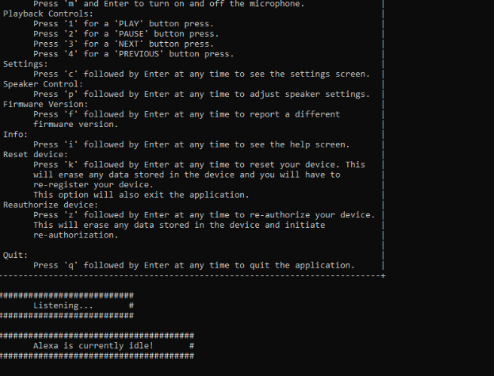
Step 6: Run the sample app
0nce authorized alexa will be in its idle state and ready to communicate

Slide 35
Error Correction
Sometime building sampleapp gives error
Sudo apt-get install libgtest-dev
Sudo apt-get install cmake # install cmake
cd/usr/src/gtest
Sudo cmake CMakeLists.txt
Sudo make

Slide 36
Making a birthday list skill
Birthday list skill helps to memorize a birth date and it also counts the number of days left in birthday.
Log in to alexa developer console using amazon developer account.
Click on create skill option
Give a name to the skill->Custom Model->Alexa hosted python->create skill.
On amazon developer console select the skill name you just created and choose edit option.
Clock on code and then you can see lambda_function.py. A template will be provided where changes could made according to user requirements.

Slide 37
Advantages
Information at glance
No need of checking phones frequently.
User Adaptive and adjustable.
All languages can be used for the plugin.
Useful for the busy person that wants to do multitasking and stay informed on the go.
No need for additional devices like laptops or mobile phones to make changes or set reminders.
Save paper or reduce paper waste.

Slide 38
Problems and weakness of system
Editing Issues-Code completion does not support typedefs for nested classes.
Debugging Issues- When debugging by GNU Compiler version, some data types will not be displayed due to missing debug information.
Design Mode Issues-The Design mode uses a QML .Executing C++ code might cause the QML layer to crash.
Skills like Music, Radio are only available in US.
Systems are not affordable by normal people.

Slide 39
References
https://github.com/Sanchana-Sanchana/Setting-Raspberry-pi-environment-for-alexa
https://developer.amazon.com/en-US/docs/alexa/alexa-voice-service/get-started-with-alexa-voice-service.html
https://github.com/SmartCalendar-Project/qt_project
https://github.com/SmartCalendar-Project

